Slide 1
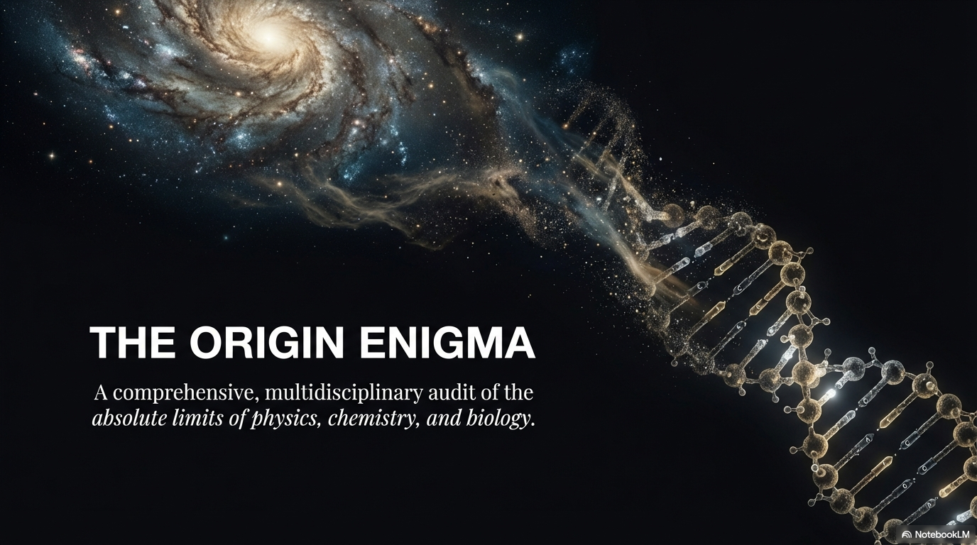
Notes:
• Welcoming the audience: "Thank you for being here. Today, I am presenting a summary of my dissertation, The Origin Enigma."
• Define the methodology: "This is not a philosophical or theological presentation. It is a strict, multidisciplinary forensic audit. We are going to look at the exact physical, chemical, and probabilistic boundaries that stand between dead matter and a living biological cell."
• Set the expectation: "Our goal is to see if unguided natural processes actually possess the causal capacity to cross this gap."

Slide 2
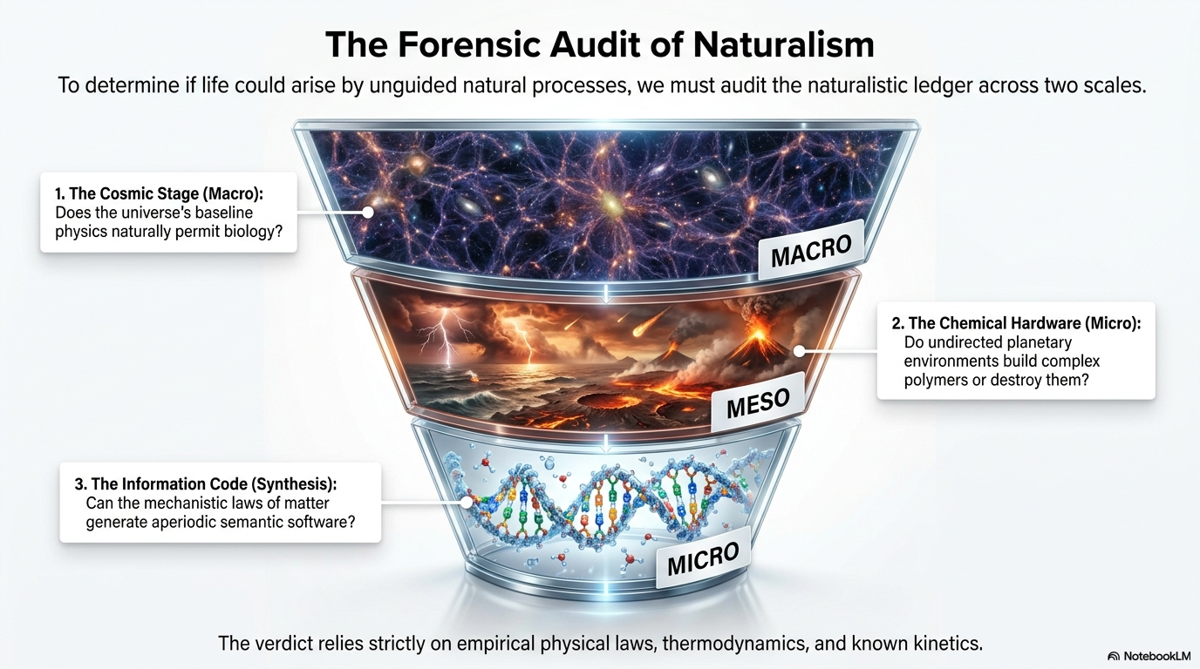
Notes:
"To determine if life could arise by unguided chemistry, we must audit the naturalistic ledger across three distinct scales."
"First, the Macro: The cosmic stage. Does the baseline physics of the universe even permit biology?"
"Second, the Meso: The chemical hardware. Do undirected planetary environments build complex polymers, or do they destroy them?"
"Third, the Micro: The information code. Can the mechanistic laws of matter generate aperiodic, semantic software?"

Slide 3
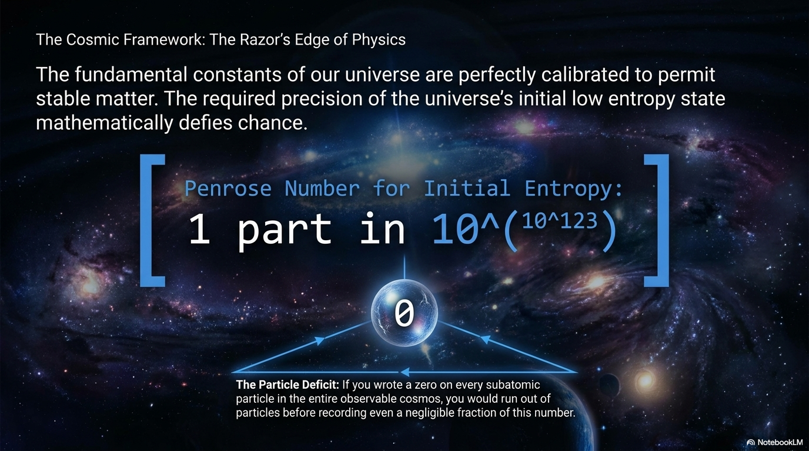
Notes:
"We begin with the cosmological baseline. The universe did not have to permit chemistry at all. The fundamental constants are calibrated on a razor’s edge."
"More profoundly, the universe began in a state of impossibly low entropy. Sir Roger Penrose calculated the probability of this initial state occurring by chance."
"The number is $1$ in ${10}^{{10}^{123}}$. As the slide notes, this is a double-exponent so massive that writing a zero on every subatomic particle in the observable universe would not even put a dent in it. The universe was born with pinpoint, mathematical precision."

Slide 4
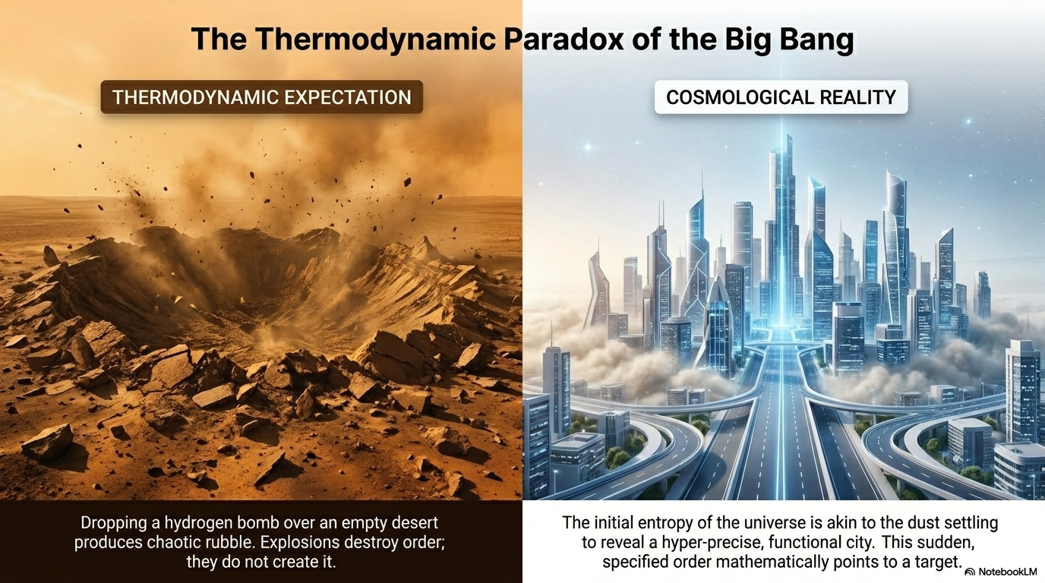
Notes:
"To visualize this thermodynamic paradox: if you drop a hydrogen bomb on a desert, you get chaotic rubble. Explosions destroy order."
"The Big Bang, however, resulted in the opposite. The initial entropy was like the dust settling from an explosion to reveal a hyper-precise, functional city. This is the first thermodynamic hurdle the materialistic model cannot explain."

Slide 5
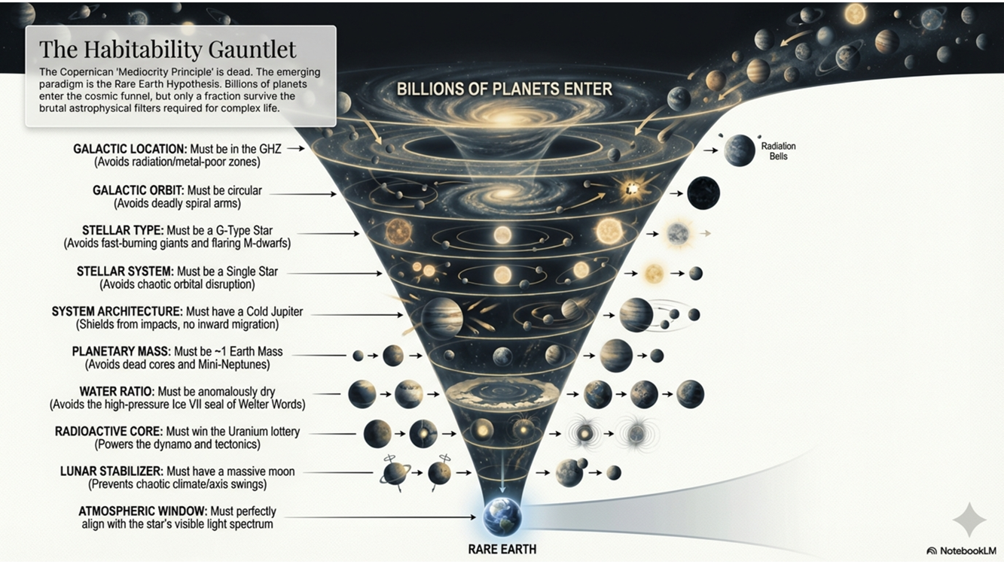
Notes:
GALAXY-SCALE ISOLATION: The Combined Rarity Barrier
Slide Content: "A narrow annular region where metallicity is high enough to form rocky planets, but radiation is low enough to allow complex life. Our solar system rests comfortably within it."
Speaker Notes:
The GHZ is the galactic equivalent of the solar habitable zone ("Goldilocks Zone").
It balances metallicity (heavy elements) and stellar stability/radiation.
Inner Galaxy (High Metallicity, High Danger): While element-rich, it's incredibly unstable, plagued by intense collective radiation, supernovae, and the central black hole.
Outer Galaxy (Low Metallicity, "Starved"): Lacks sufficient heavy elements to form terrestrial, rocky worlds.
Sun's Perfect Position: The Sun's nearly circular orbit keeps us safely within this unique, protected region, avoiding irradiated inner areas or barren outer zones.
Slide Content: "The central region of the galaxy. Exorbitant stellar density, extreme radiation, and supermassive black hole ensure total annihilation of any potential life."
Non-Migrating Orbit (Hot Jupiter Problem)
Slide Content: "Most planetary systems observe orbital migration where 'Hot Jupiters' move inward, destroying all inner rocky worlds. Solar System architecture is critically non-migrating."
Why Hot Jupiters Move Inward: Gravitational drag from the protoplanetary disk forces these giant planets to spiral inward toward their star soon after formation.
Deadly Consequence: These massive planets act as cosmic snowplows, using their immense gravity to scatter or destroy all inner, rocky worlds (potential Earths) in their path, leaving barren systems.
Our Unique Non-Migrating System: Our gas giants (Jupiter and Saturn) formed further out and stayed put. This critically non-migrating architecture has been our salvation, allowing the inner Goldilocks planets to form and stabilize.
Why Earth Mass is Crucial:
(Speaker Notes: Even with perfect galactic and system architecture, the planet's mass determines its surface gravity, which is fundamental for habitability:
Atmospheric Retention: A lower-mass planet (like Mars) cannot hold onto a dense atmosphere over billions of years, losing radiation protection, pressure, and temperature regulation. A higher-mass planet becomes a gas giant with no solid surface.
Geological Activity: The "just right" mass provides internal heat for plate tectonics and a magnetic shield (geodynamo) that deflects deadly particles and regulates climate. Earth has the perfect mass to hold conditions for complex life.

Slide 6
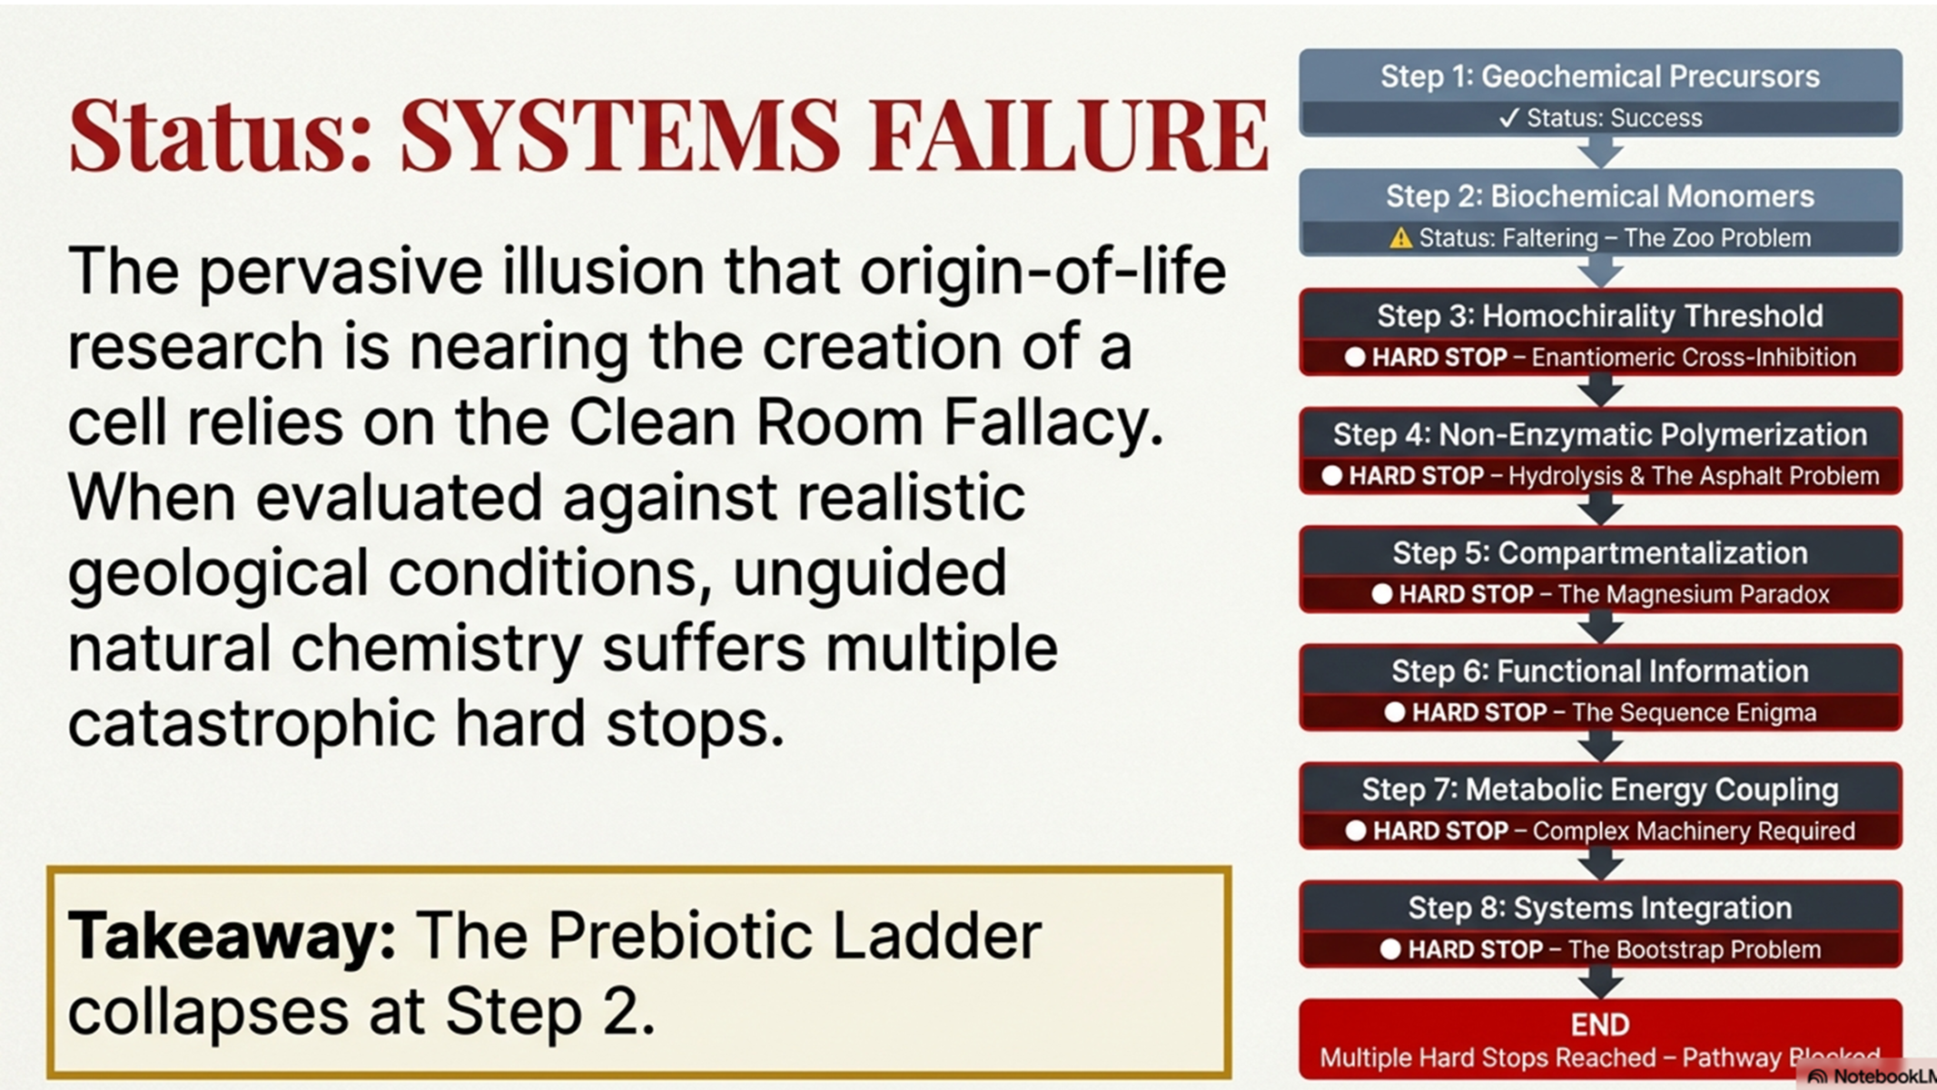
PARTIAL
Notes:
The Ladder of Life
"This brings us to the core of the biological audit: The 8 Stages to a Living Cell."
"Materialistic models often blur these stages together to borrow explanatory power. In reality, each of these 8 steps represents a distinct, unyielding physical barrier—a hard stop."
"Chemistry actively opposes climbing this ladder. Let's look at a few of the most brutal hard stops."

Slide 7
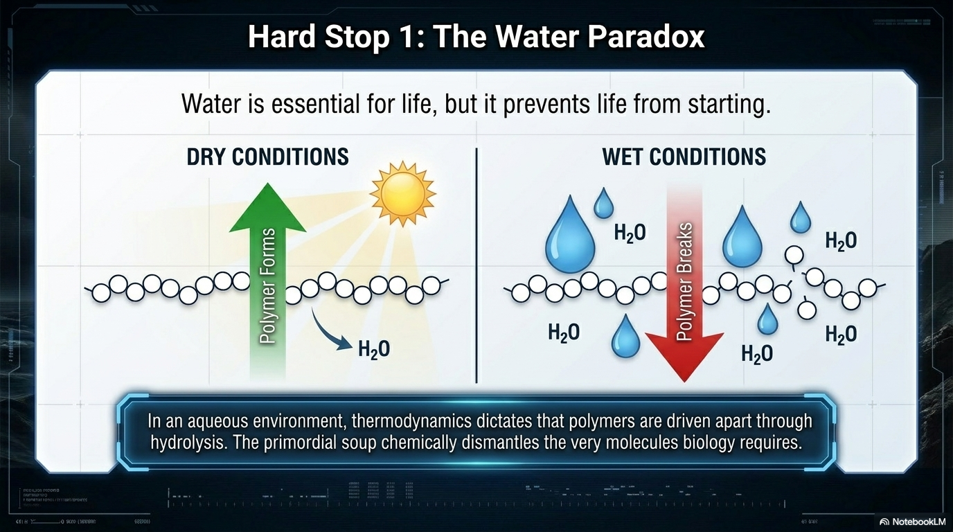
Notes:
Hard Stop 1 - The Water Paradox
"The Polymerization Hurdle. Life requires water, but water prevents life from starting."
"To build a protein, amino acids must link together via peptide bonds. This is a condensation reaction—it releases water."
"In an ocean, thermodynamics drives this reaction violently backward as water can not be released. Ocean Water breaks the bonds through hydrolysis. The primordial soup chemically dismantles the very molecules biology requires.“
Under dry conditions, Instead of cleanly organizing into functional long chain of molecules, the continuous drying phase forces unguided organic molecules to react uncontrollably. Without biological enzymes to direct them, they cross-link into a complex, messy mixture—a prebiotic dead-end known as the 'asphalt problem. The most well known of such reactions is the Mailard reaction.

Slide 8
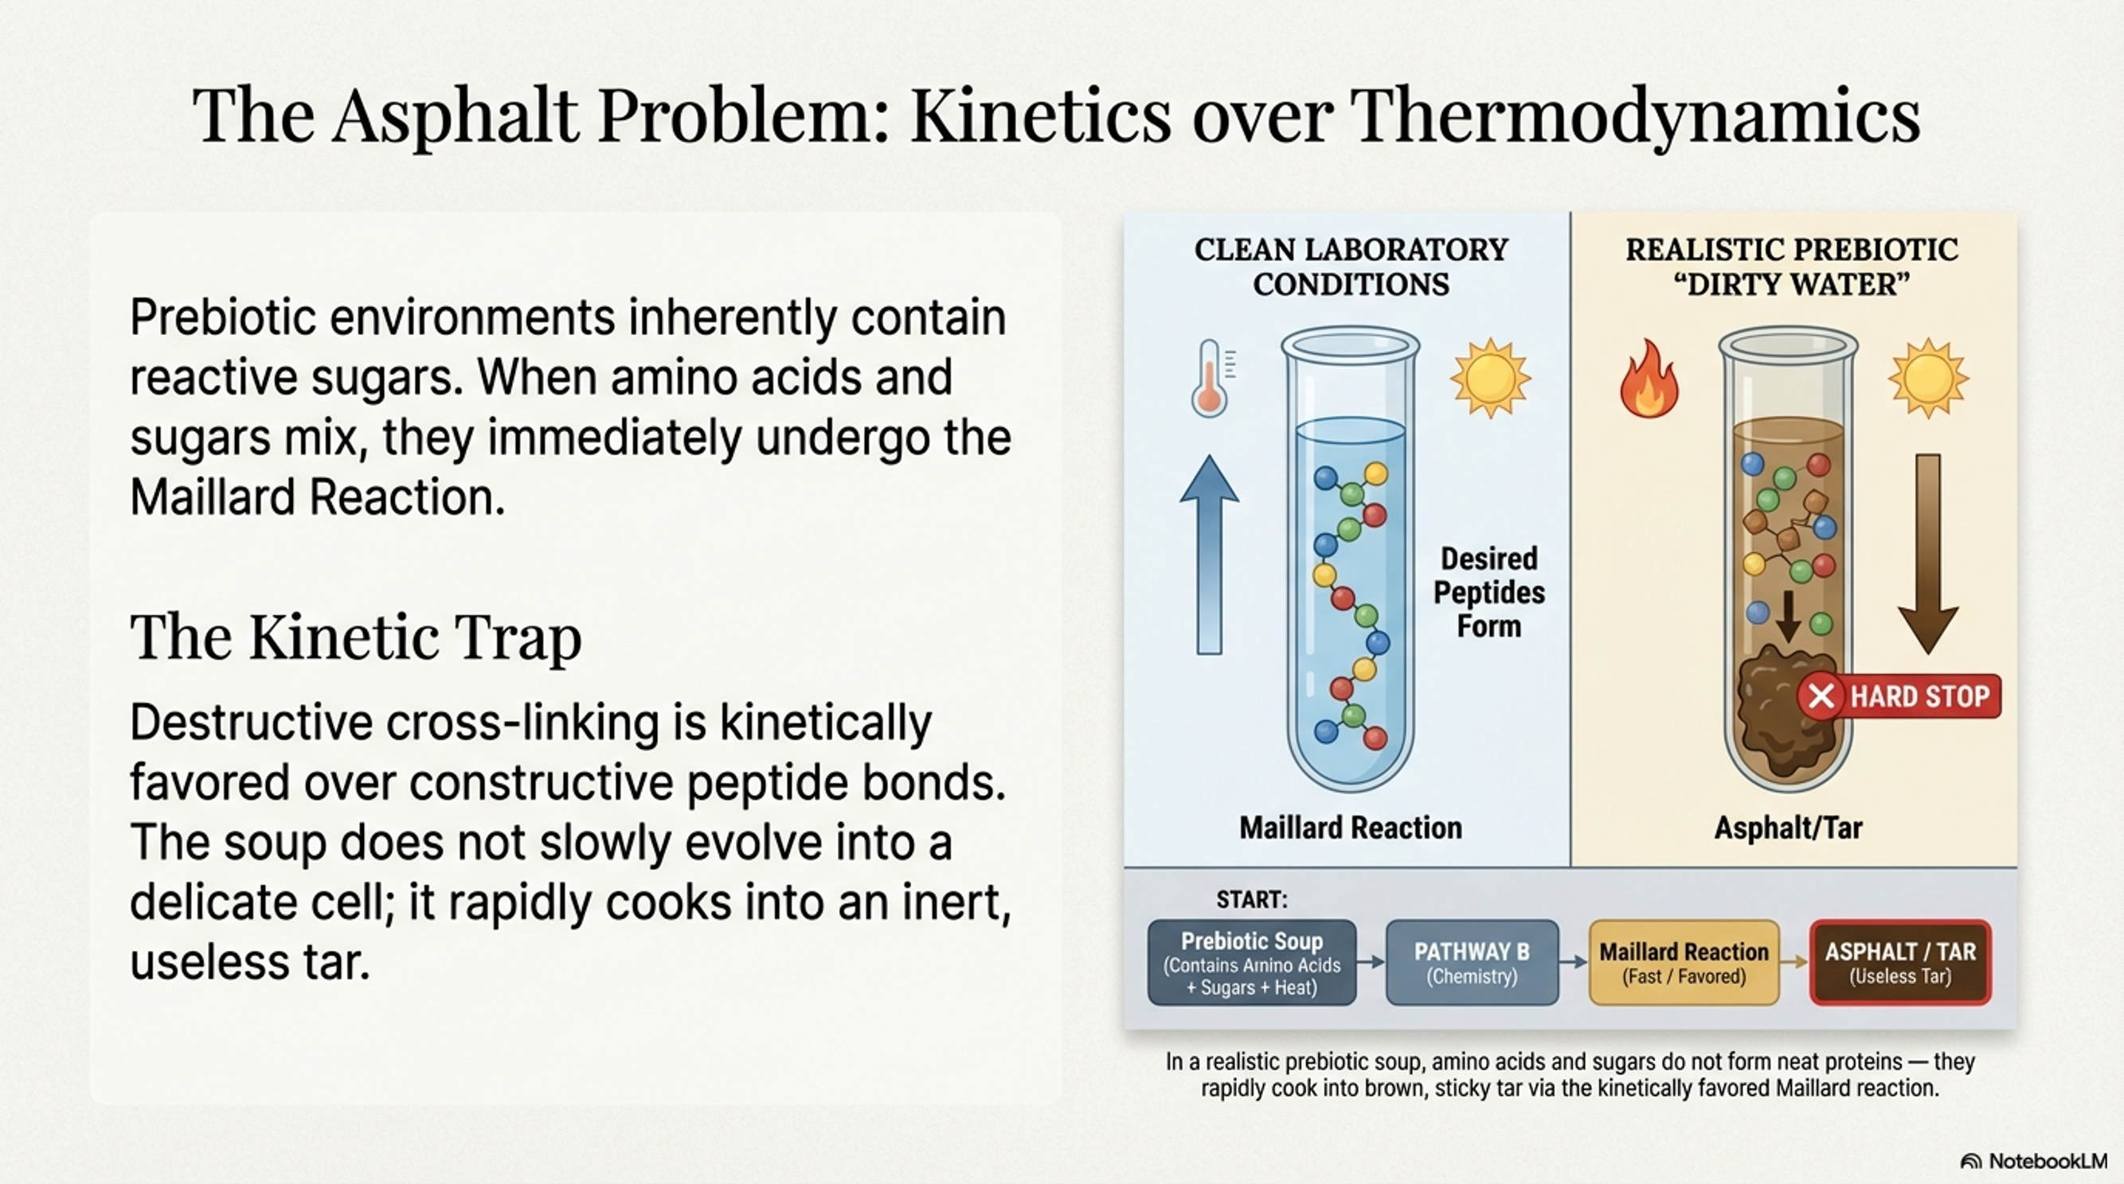
Notes:
Hard Stop 2 - The Asphalt Problem
"Even if we force molecules together, we hit the Asphalt Problem."
"When you mix amino acids and sugars in a prebiotic pool and add heat or energy, they do not naturally fold into biological proteins."
"They undergo the Maillard Reaction. They irreversibly cross-link into a useless, insoluble brown tar. This reaction happens millions of times faster than functional protein formation."

Slide 9
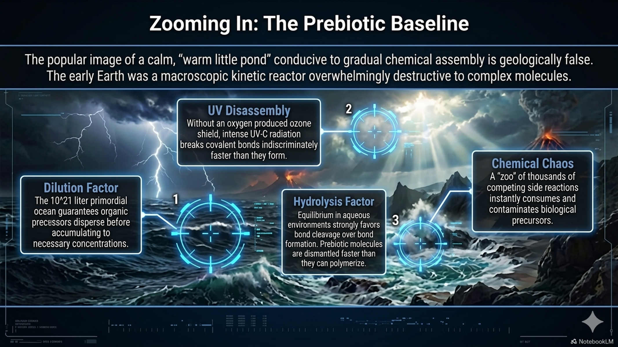
Notes:
Zooming In - The Prebiotic Baseline
"Moving from the cosmos to the Hadean Earth. The popular image of a calm 'warm little pond' slowly building life is geologically false."
"The early Earth was a macroscopic kinetic reactor. It was overwhelmingly destructive."
"Without an ozone shield, UV radiation dismantled molecules as fast as they formed. The ocean diluted precursors so they could never reach necessary concentrations. It was a zoo of competing, chaotic chemical reactions."

Slide 10
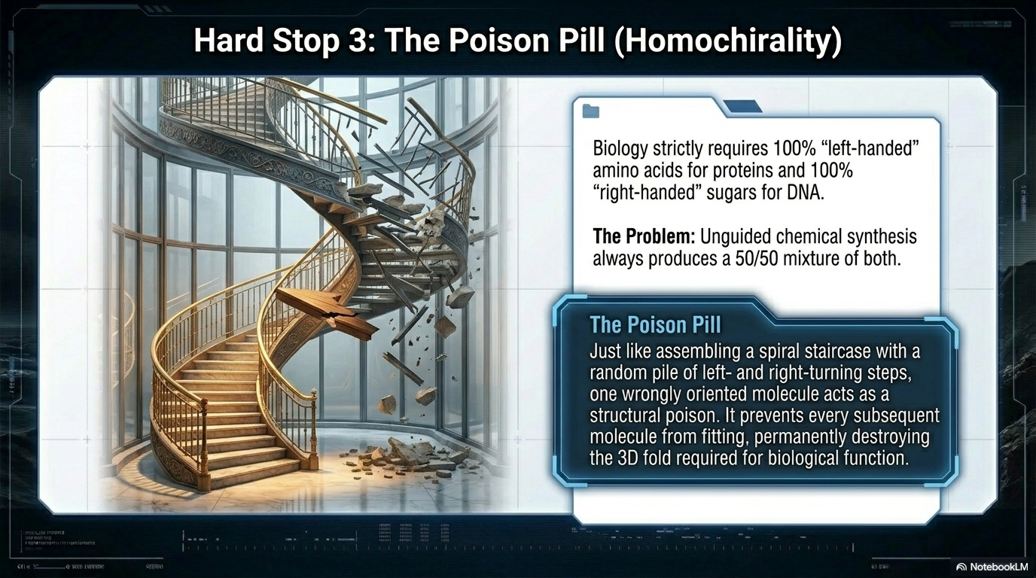
Notes:
Hard Stop 3 - The Poison Pill (Homochirality)
"The chirality hurdle is absolute. Unguided chemistry always produces a 50/50 mixture of left- and right-handed molecules."
"Biology strictly requires 100% purity—exclusively left-handed amino acids."
"If you are building a spiral staircase, inserting a single right-handed molecule acts as a structural poison. It prevents all subsequent folding, destroying the biological function. There is no known unguided way to separate a racemic soup into a pure reservoir."

Slide 11
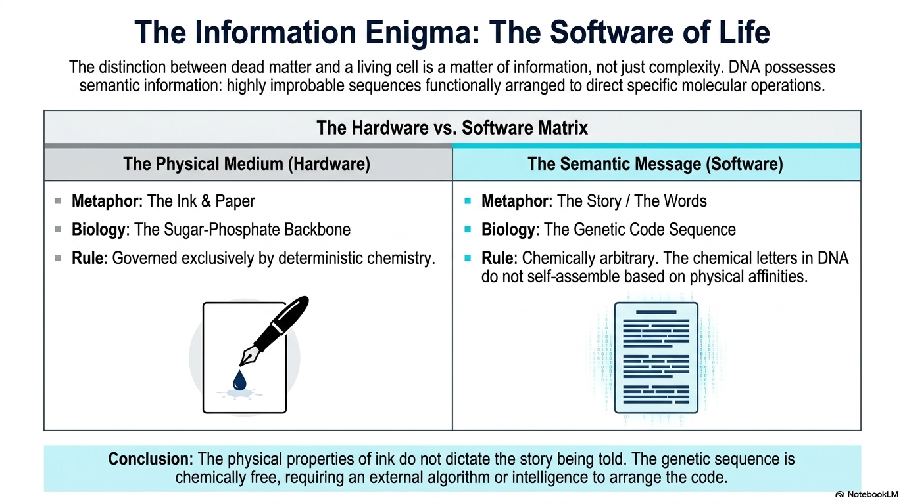

Slide 12
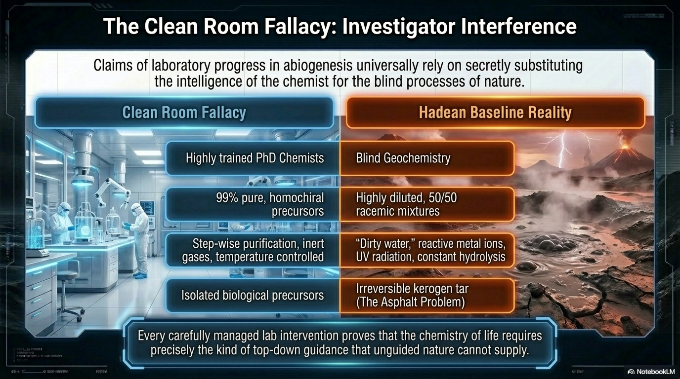
Notes:
The Clean Room Fallacy - Investigator Interference
"So how do scientists claim to create the 'building blocks of life' in labs?"
"They rely on Investigator Interference. They use highly trained PhD chemists, 99% pure precursors, step-wise temperature control, and artificial cold traps."
"They do not replicate blind Hadean geochemistry. They secretly substitute their own intelligence to bypass the thermodynamic barriers that nature cannot."

Slide 13
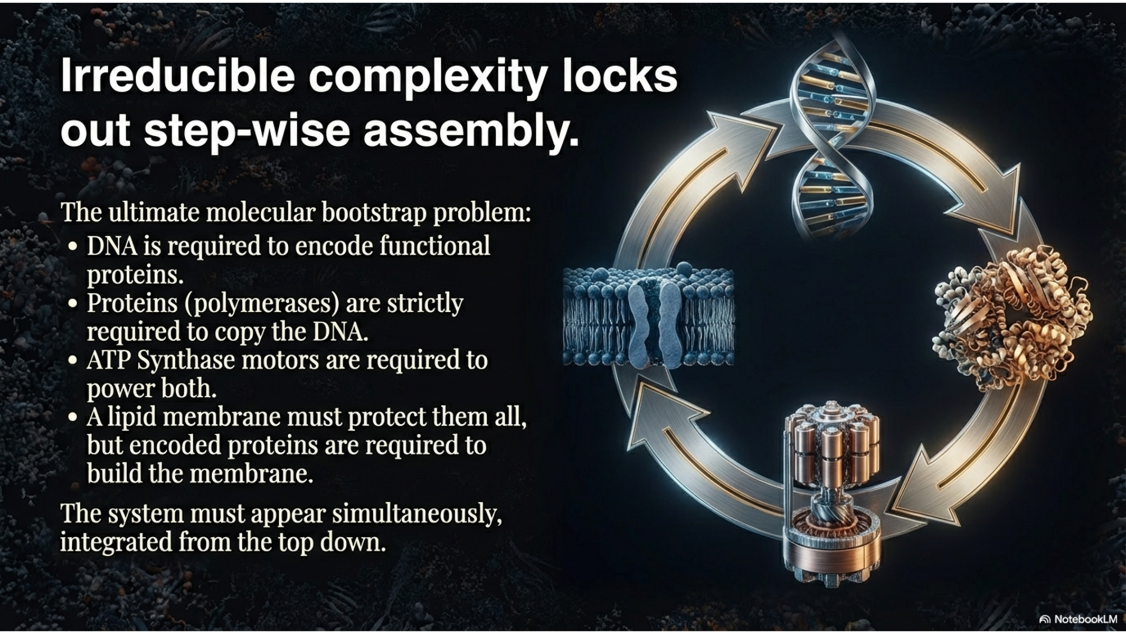
Notes:
The Bootstrap Paradox - Irreducible Complexity
"Stage 8 is the ultimate chicken-and-egg problem."
"DNA contains the blueprint for proteins. But proteins (the machinery) are required to read and copy the DNA. Both require ATP Synthase (the motor) for energy. And ATP Synthase is built by the DNA.“
How Proteins "Read" DNA (Transcription) DNA never leaves its safe room (the nucleus of a cell). To get the instructions out to the rest of the cell, it must be "read" and transcribed into a temporary note called RNA. Unzipping the Book: DNA is tightly wound like a twisted ladder. A specialized protein machine called Helicase physically grabs the DNA and unzips it so the inside can be seen. Scanning the Letters: Another massive protein machine called RNA Polymerase latches onto the exposed DNA strand. It physically walks down the DNA line, reading the chemical letters (A, T, C, G) one by one. Writing the Note: As it reads, this protein stamps out a matching copy made of RNA like a 3d printer.
"You cannot construct a factory without the machinery, and you cannot manufacture the machinery without the factory.

Slide 14
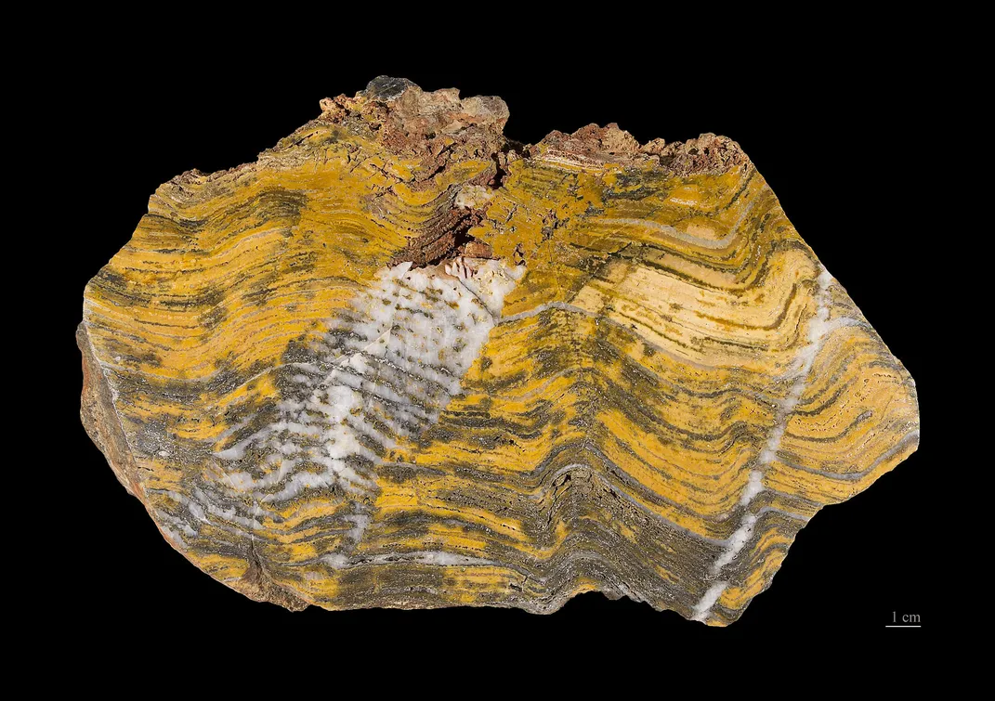
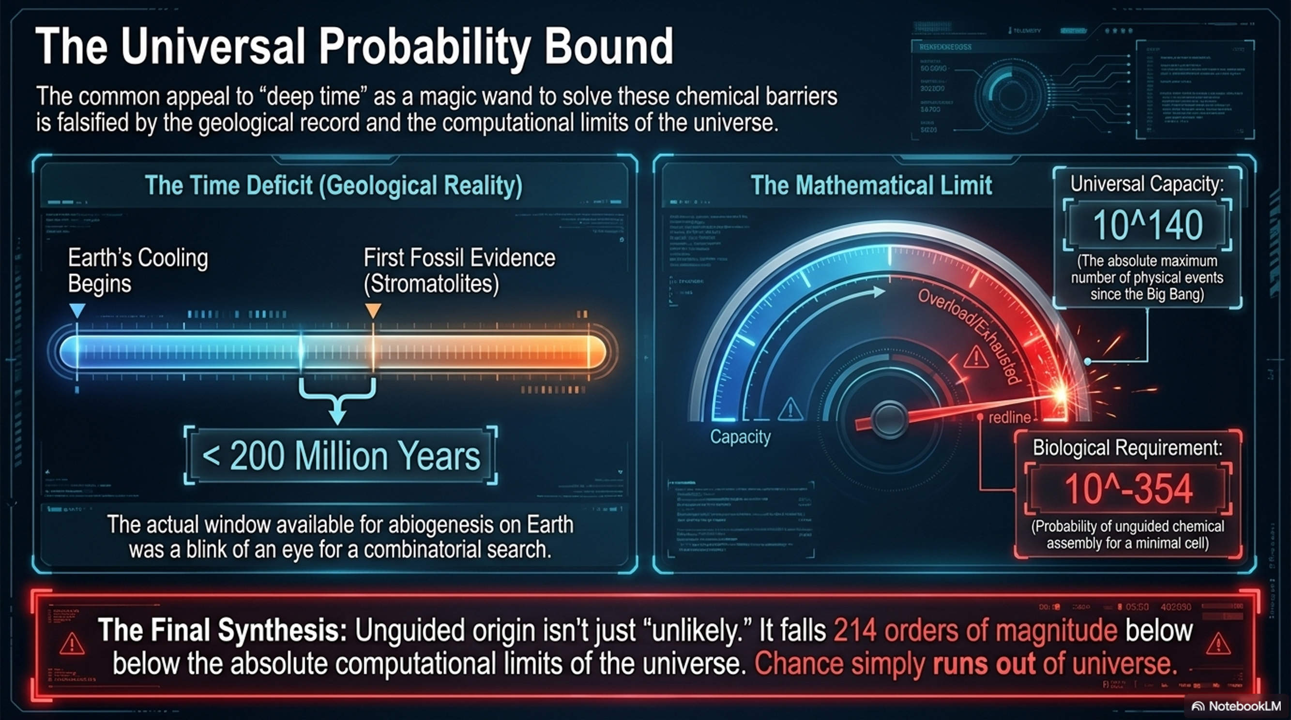
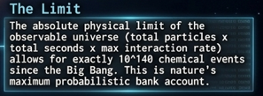
3.5b. Year old life
Notes:
Mathematical Synthesis - The Universal Probability Bound (particles x seconds x planck length)
"When we synthesize this mathematically, the materialistic model breaks completely."
"The probability of assembling a single, functional protein sequence is $1$ in ${10}^{77}$. For a minimal cell, the probability falls to $1$ in ${10}^{195}$."
"This falls hundreds of orders of magnitude below the absolute computational limit of the universe. The spontaneous assembly of life is not just unlikely; it is physically and mathematically foreclosed."

Slide 15
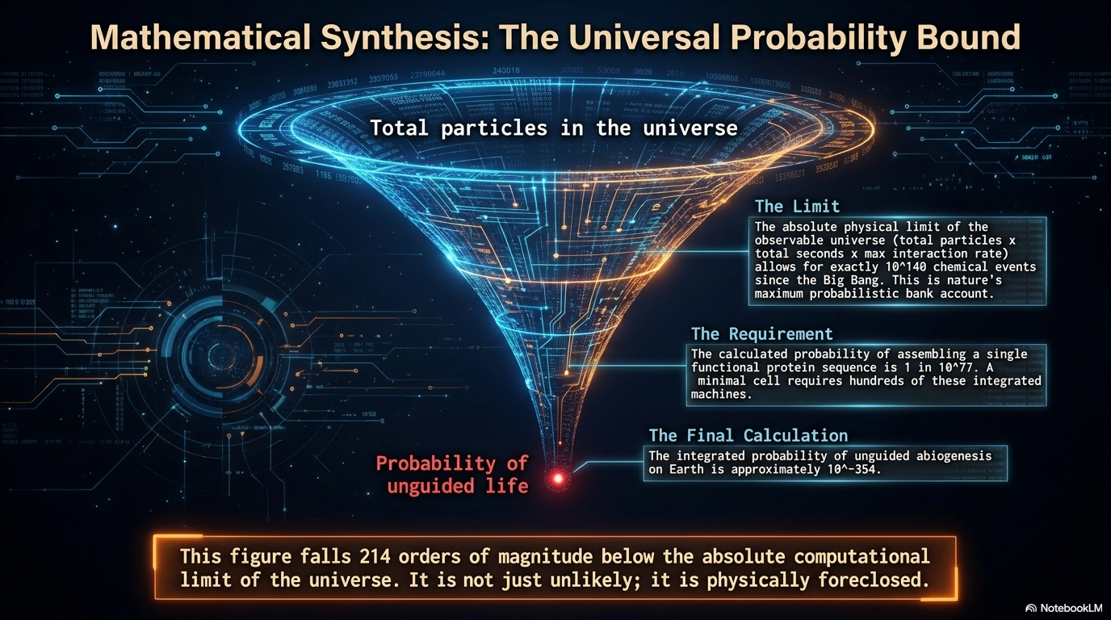
Notes:
Mathematical Synthesis - The Universal Probability Bound
"When we synthesize this mathematically, the materialistic model breaks completely."
"The probability of assembling a single, functional protein sequence is $1$ in ${10}^{77}$. For a minimal cell, the probability falls to $1$ in ${10}^{195}$."
"This falls hundreds of orders of magnitude below the absolute computational limit of the universe. The spontaneous assembly of life is not just unlikely; it is physically and mathematically foreclosed."

Slide 16
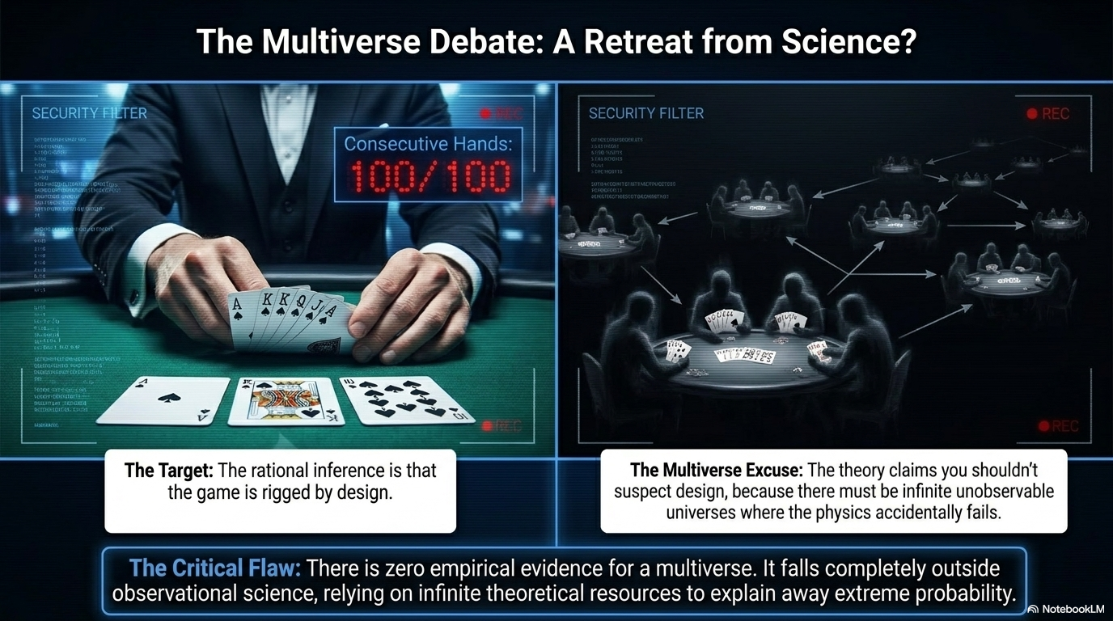
Notes:
"To escape this mathematical impossibly, many theorists retreat to the Multiverse."
"Imagine a gambler drawing a Royal Flush 100 consecutive times(Ace, King, Queen, Jack, and 10 of the same suit). The rational inference is that the game is rigged. The Multiverse excuse argues that there are simply infinite unseen poker tables, so someone was bound to win.“
The exact probability of drawing a Royal Flush 100 consecutive times is 5.32 × 10⁻⁵⁸²,
"The critical flaw here is empirical. There is zero observational evidence for a multiverse. It abandons observational science to explain away extreme probability."

Slide 17
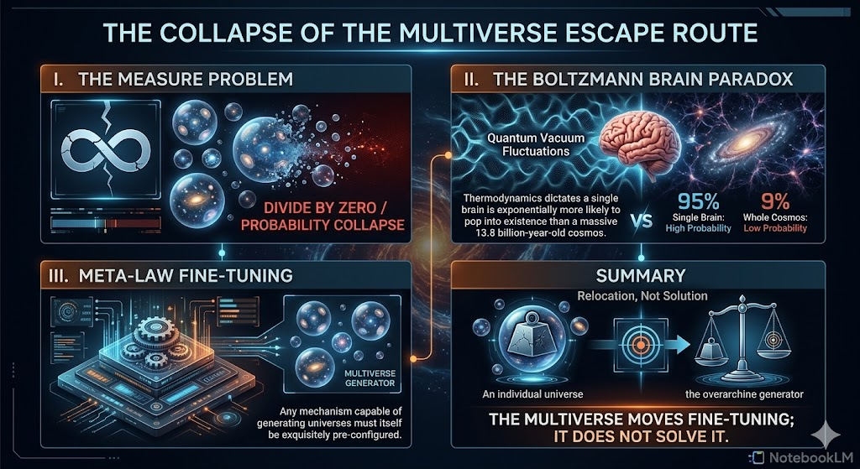
Notes:
Slide 6: The Collapse of the Multiverse Escape Route
"Even if we grant a Multiverse, it collapses under its own physics."
"It suffers from the Measure Problem—calculating probabilities across infinity breaks the math."
"It suffers from the Boltzmann Brain Paradox—thermodynamics dictates it is infinitely more likely for a single hallucinating brain to pop into existence than a massive 13.8-billion-year-old cosmos."
"And finally, the Meta-Law problem. Any mechanism capable of generating universes must itself be exquisitely fine-tuned. The Multiverse does not solve fine-tuning; it merely relocates it."

Slide 18
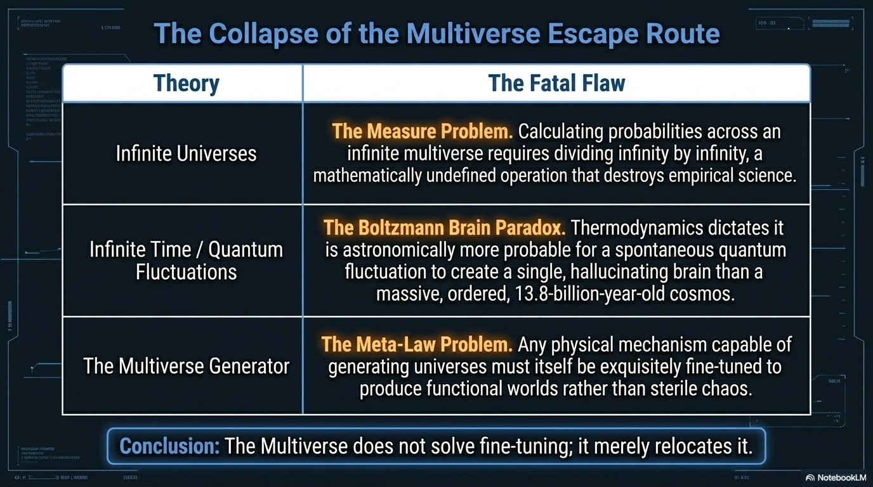

Slide 19
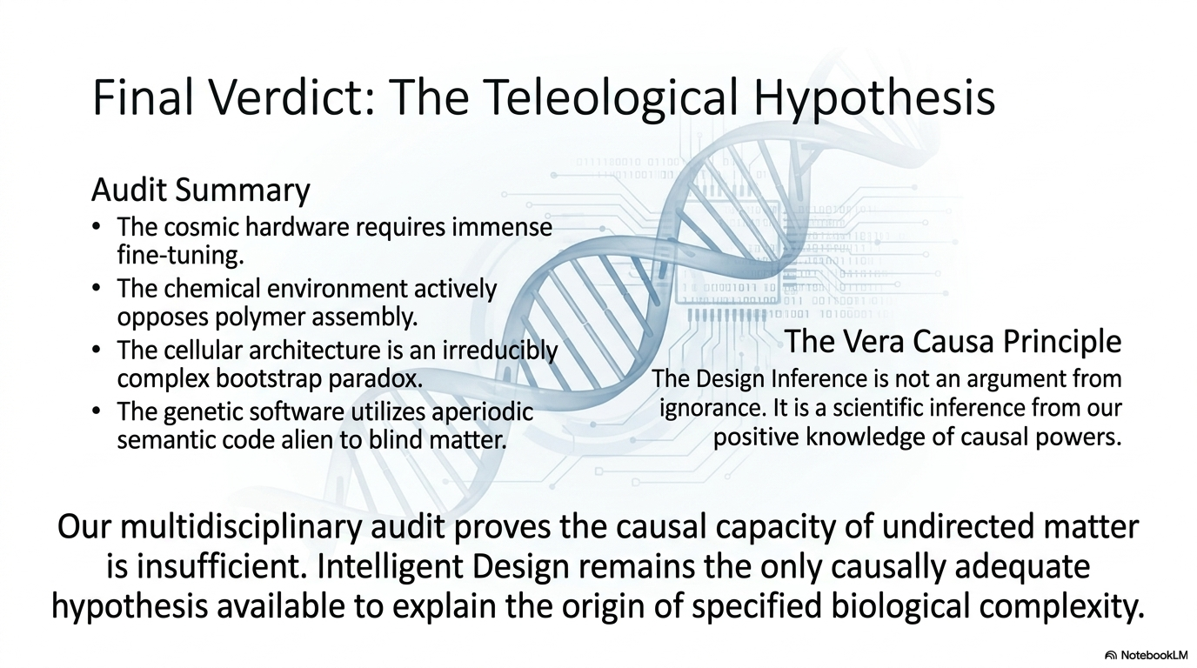
Notes:
Final Verdict - The Teleological Hypothesis
Summarize the Audit: "The cosmic hardware requires immense fine-tuning. The chemical environment actively opposes assembly. The cellular architecture is irreducibly complex."
The Vera Causa Principle: "We are left with genetic software utilizing aperiodic, semantic code. Based on the strict uniformitarian rules of historical science—vera causa—the only known cause capable of generating digital code and irreducible machinery is a conscious intelligence."
Conclusion: "The Design Inference is not an argument from ignorance. It is a scientific inference from positive knowledge of causal powers. Intelligent Design remains the only causally adequate hypothesis available to explain the origin of life. Thank you."

Slide 20
THE END

